Slide 1


Department of Computer Science and Engineering
VISUAL AUDIO FOR VISIONLESS USING DEEP LEARNING
R.Preethi (211419104202)
G.Renuka (211419104220)
Veerapareddy Divya (211419104298)
Guide Name & Designation
Coordinator Name & Designation
Mrs. D. Jennifer M.E (PhD)
Assistant Professor
Dr. K. Valarmathi, M.E., Ph.d
Professor

Slide 2
Introduction
The sense of sight is incredibly important for human beings, and its absence can significantly impact an individual's quality of life.
Visual Audio for visionless is a task of generating descriptions for an image in both textual and audible form.
The challenging task in the process is to understand and generate both semantic and syntactically correct sentence.
Main aim of this project is to support visually impaired people which is implemented using Inception V3 model.

Slide 3
Objective of the Project
The main objective of the project is to help the visually impaired people in the following ways:
1) Assistance for Visually Impaired
2) Accessing information
3) Mobility and safety
4) Social interaction
5) Employment
6) Education

Slide 4
Literature Survey
S.No. | Title | Journal | Year | Description/Advantage | Disadvantage
1 | Hybrid Architecture using CNN and LSTM for Image Captioning in Hindi Language | IEEE Access | 2023 | Proposes a hybrid architecture for generating image captions in Hindi using CNNs and LSTMs | Focused on Hindi language, may not generalize well
2 | Image captioning for effective use of language models in knowledge-based visual question answering | Springer | 2023 | Proposes a method for generating image captions for visual question answering using pre-trained language models and a novel loss function | Limited to image captioning using only CNNs

Slide 5
Literature Survey
S.No. | Title | Journal | Year | Description/Advantage | Disadvantage
3 | VATEX2020: pLSTM framework for video captioning | Springer | 2023 | Proposes a video captioning framework using parallel LSTMs, achieves state-of-the-art results on VATEX2020 dataset | May not be effective for complex video sequences
4 | Survey of explainable artificial intelligence techniques for biomedical imaging with deep neural networks | IEEE Access | 2023 | Provides a survey of techniques for making deep neural networks more interpretable in biomedical imaging | Does not provide comparative evaluation of effectiveness

Slide 6
Literature Survey
S.No. | Title | Journal | Year | Description/Advantage | Disadvantage
5 | Attention Over Attention: An Enhanced Supervised Video Summarization Approach | Expert Systems with Applications | 2023 | Proposes an attention-based approach for video summarization, achieves state-of-the-art results on various datasets | Not evaluated on a large-scale dataset
6 | Artificial intelligence for visually impaired | IEEE Access | 2023 | Proposes a system for assisting visually impaired people using object detection and text-to-speech technology | Limited evaluation of the system

Slide 7
Problem Statement
Blindness or visual impairment can create several challenges for individuals, including:
Accessing information
Mobility and safety
Social interaction
Employment
Education
Mental health
It is important to provide resources and support to individuals who are blind to help them overcome these challenges and live full, independent lives.

Slide 8
Proposed System
In the proposed system, the innovation is that the implementation can be done with recent algorithm and the generated caption can be converted to voice.
This implementation is carried with two or more algorithm together as a trial and error method to increase the accuracy.
The possible algorithm that are useful for this purpose is Inception V3 and LSTM.
This is a new innovation for the visually impaired people.
This will help the to move without any external support.

Slide 9
Proposed System
Existing Algorithm
Step1: Input Embedding
Step2: Positional Encoding
Step3: Multi-Head Self-Attention
Step4: Layer Normalization
Step5: Feedforward Network
Step6: Residual Connection
Step7: Layer Normalization
Step8: Output
Proposed Algorithm
Step1: Input Image
Step2: Preprocessing
Step3: Convolutional Layers
Step4: Inception Modules
Step5: Pooling Layers
Step6: Fully Connected Layers
Step7: Softmax Layer
Step8: Output

Slide 10
Software / Hardware used
HARDWARE REQUIREMENT
Processor: Intel Core i5
RAM: 512 MB and above
Hard Disk: 40 GB and above
SOFTWARE REQUIREMENT
Backend: PYTHON
Frontend: TKINTER
Technology: Deep Learning
Operating System: Windows 7
Tools: Anaconda Navigator /TensorFlow/Jupyter/Colab

Slide 11
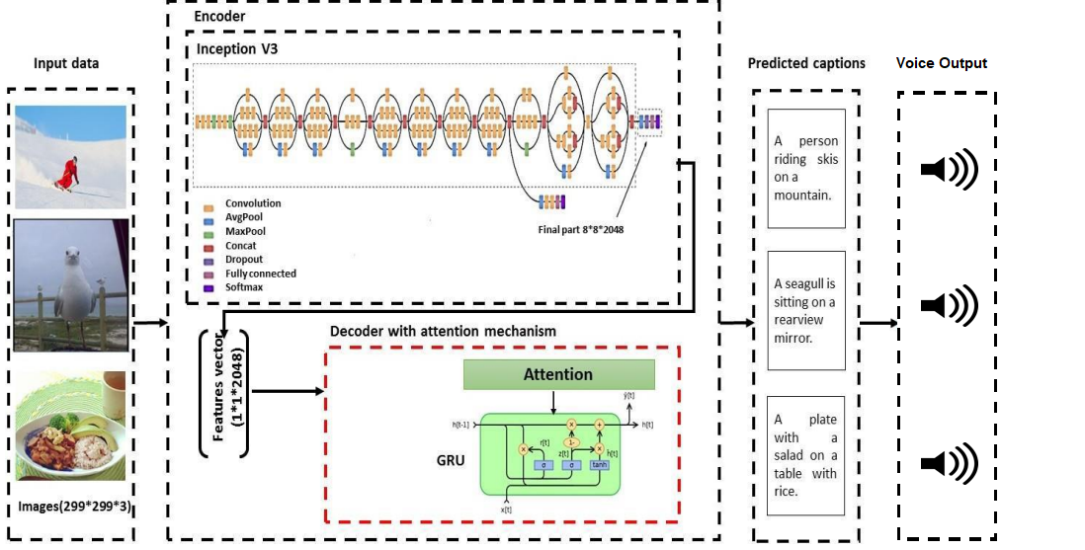
Architecture Diagram

Slide 12
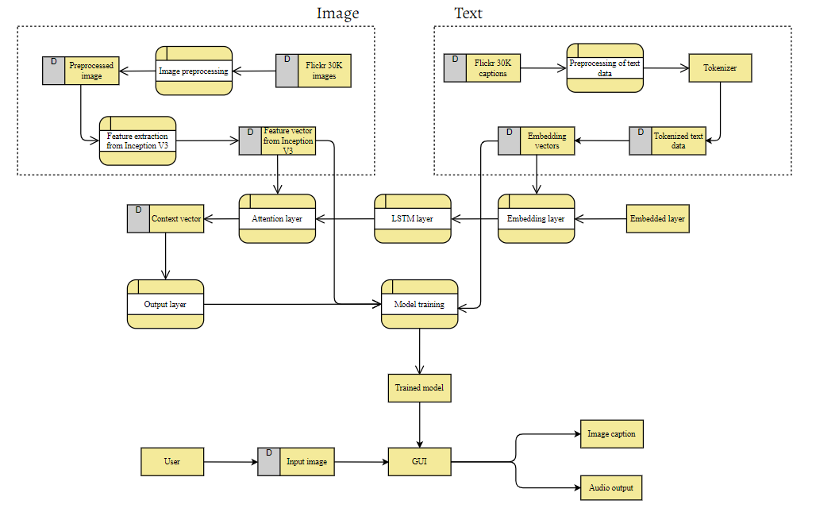
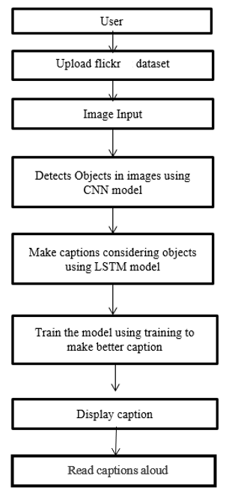
System Design
Data Flow Diagram:
Flow Chart:

Slide 13
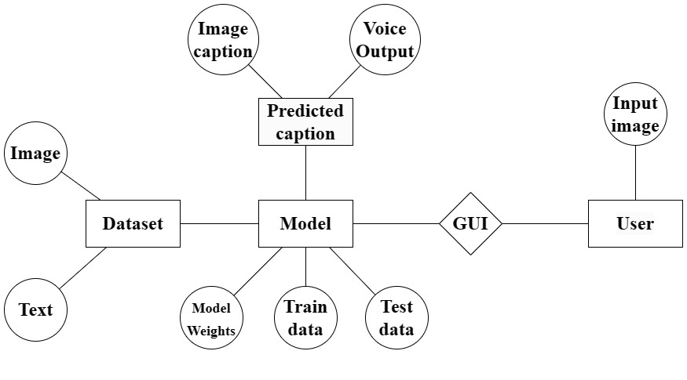
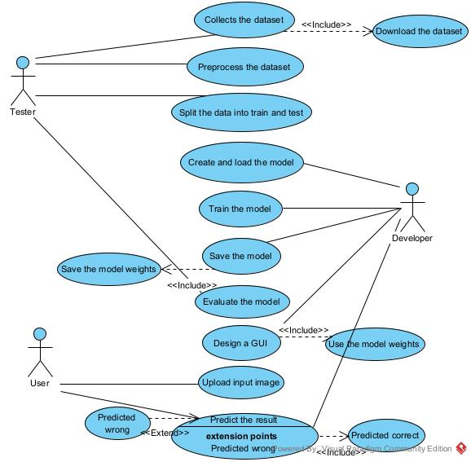
System Design
ER Diagram:
Use Case Diagram:

Slide 14
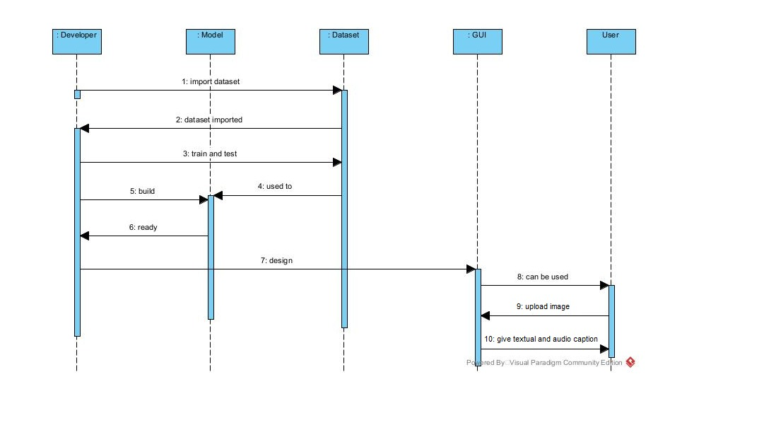
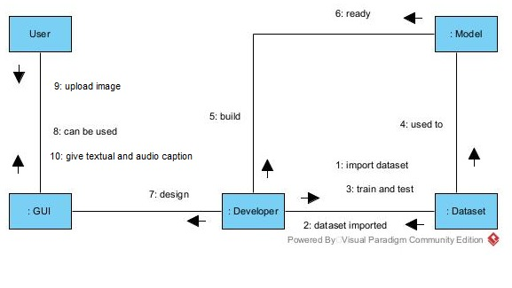
System Design
Sequence Diagram:
Collaboration Diagram:
Slide 11 to 13
Flow Chart/DFD/ER Diagram/Use case Diagram/Collaboration /Sequence Diagram

Slide 15
Module Description
CNN is used to extract visual features from the input image, which are then fed into a language model to generate the caption.
The process of image captioning with Inception v3 involves several steps. First, the input image is pre-processed to a fixed size and normalized to zero mean and unit variance.
This ensures that the image has a consistent format and makes it easier for the CNN to extract relevant visual features.

Slide 16
Module Description
Next, the pre-processed image is fed into the Inception v3, which extracts visual features from the image.
CNN uses a combination of convolutional and pooling layers to capture different levels of abstraction of the image.
The output of the CNN is a set of feature maps that represent the visual information in the image.
The feature maps are then flattened and fed into a language model, which generates the caption.

Slide 17
Module Description
The language model takes the visual features as input and generates a sequence of words that describe the image. The sequence of words can be optimized using a loss function that compares the generated captions to ground truth captions.
One advantage of using Inception v3 for image captioning is its ability to extract high-level features from images.
The architecture is designed to capture a wide range of visual features, from low-level details to high-level features such as object categories and scene contexts.

Slide 18
Module Description
Another advantage of using Inception v3 is its computational efficiency.
The architecture is relatively lightweight compared to other CNN architectures, such as ResNet or VGG, which makes it faster and more memory-efficient.
This can be particularly advantageous when dealing with large datasets or deploying the model on resource-constrained devices.

Slide 19
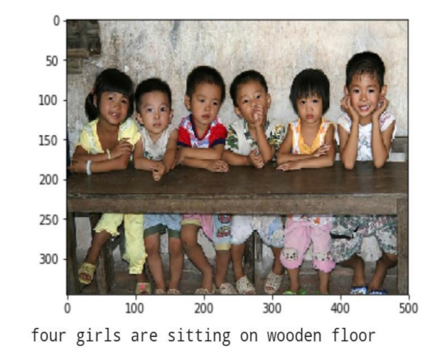
Testing
This is the first level of testing.
In these different modules are tested against the specifications produced during the design of the module.
During this testing the number of arguments is compared to input parameters, matching of parameter and arguments etc.
It is also ensured whether the file attributes are correct, whether the Files are opened before using, whether Input/output errors are handled etc.

Slide 20
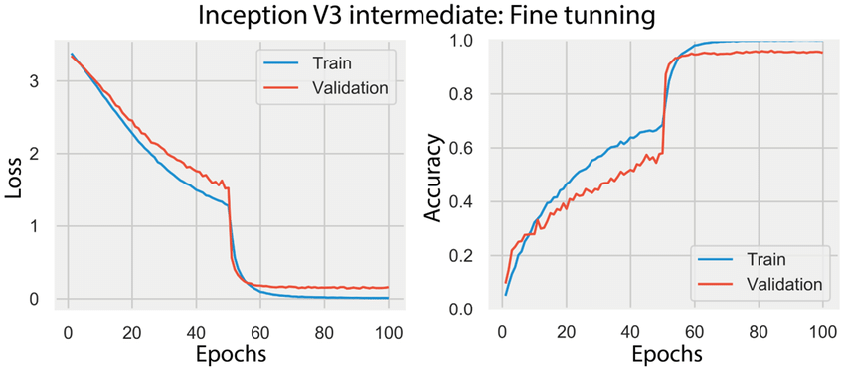
Results
According to the trained model, it is observed that the percentage of the accuracy is gradually increasing with respect to the number of epochs.
According to continuous improvement is found till the epoch 50, after which the accuracy has achieved to a certain level with 89% of accuracy and no other improvements are found for further epochs.
The output of the model is generated in both description and audio form.

Slide 21
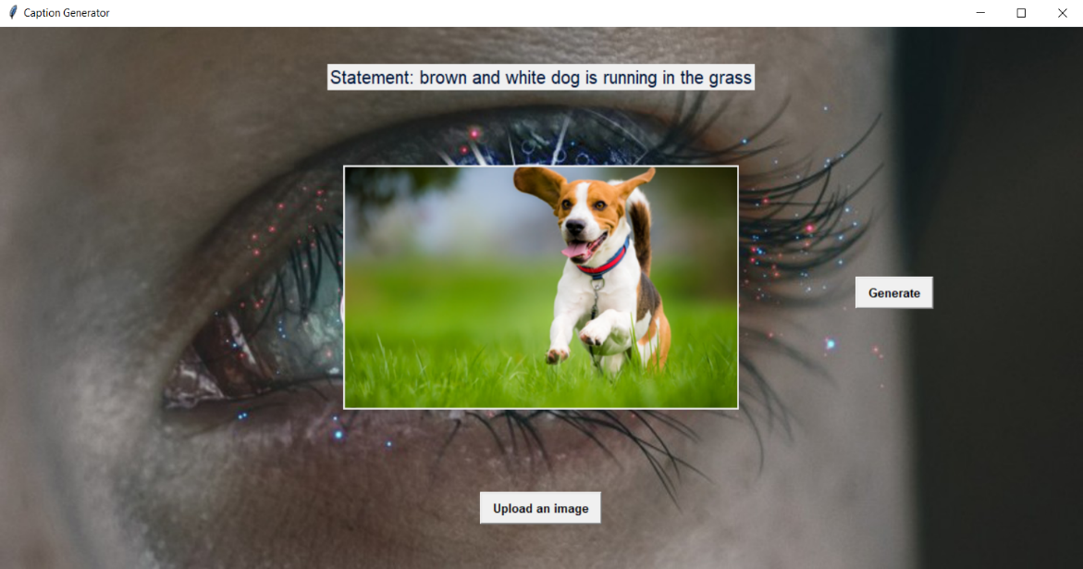
Screen Shots

Slide 22
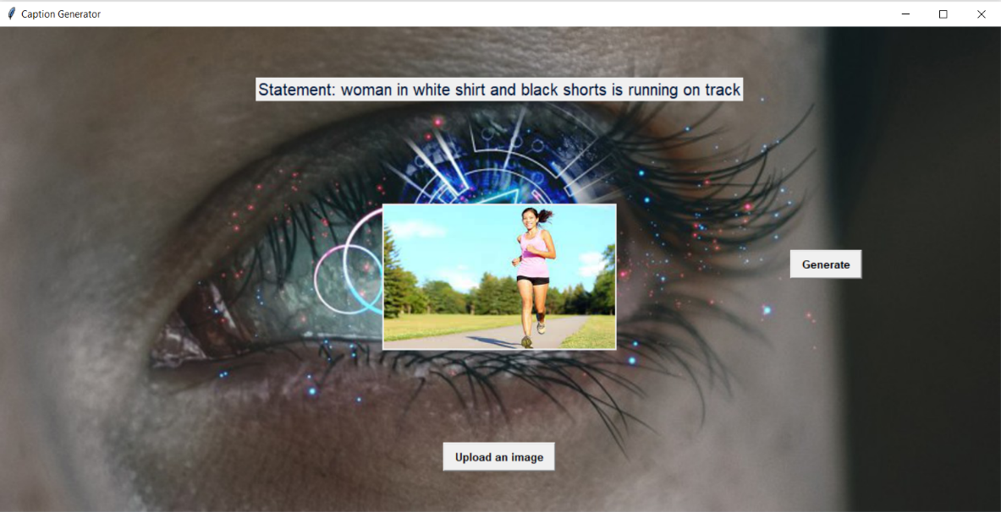
Screen Shots

Slide 23
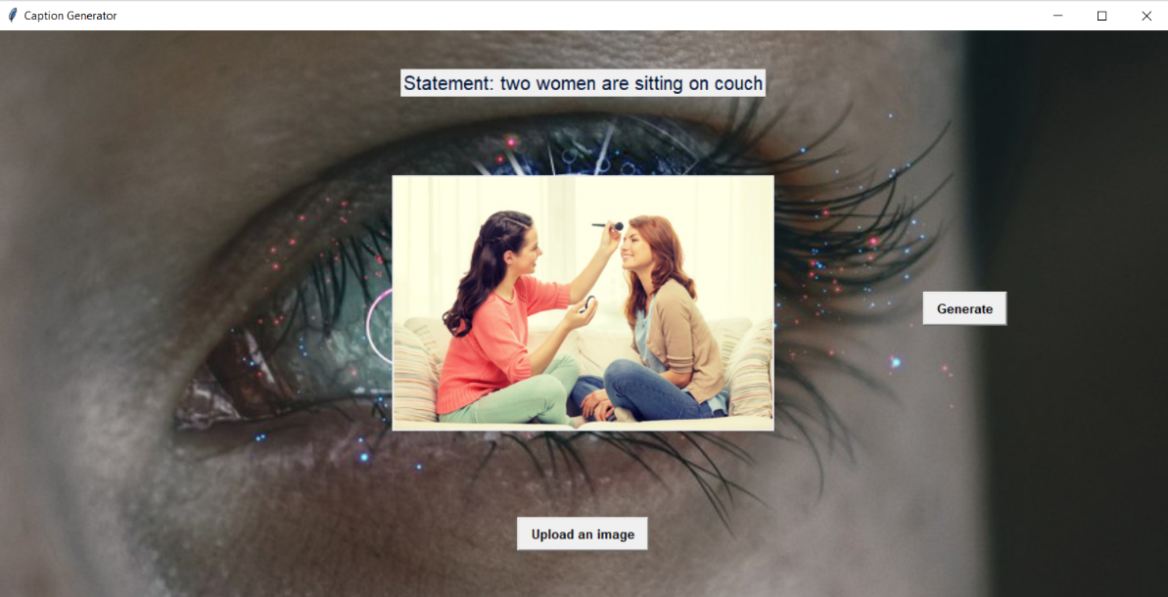
Screen Shots

Slide 24
Conclusion
In this paper, we present a combination of image captioning using Inception V3 and TTS (Text-To-Speech) model which successfully generate the textual and audible captions for images with high accuracy.
The use of Inception V3 for feature extraction and an LSTM network with attention mechanism for sequence generation has proven to be effective in generating coherent and meaningful captions for a wide range of images.
The model is trained on the Flickr 30k dataset for increasing the performance.
Additionally, the model could be trained on a larger and more diverse dataset (like MSCOCO) to further improve its performance and adaptability to various images.

Slide 25
Base Paper Link
https://ieeexplore.ieee.org/abstract/document/9739703

Slide 26
Reference Paper
[1] Ayush Kumar Poddar, Dr. Rajneesh Rani “Hybrid Architecture using CNN and LSTM for Image Captioning in Hindi Language” Procedia Computer Science, Volume 218, 2023. https://doi.org/10.1016/j.procs.2023.01.049
[2] Ander Salaberria , Gorka Azkune, Oier Lopez de Lacalle, Aitor Soroa, Eneko Agirre “Image captioning for effective use of language models in knowledge-based visual question answering” Expert Systems with Applications, Volume 212, 2023. https://doi.org/10.1016/j.eswa.2022.118669
[3] Alok Singh, Salam Michael Singh, Loitongbam Sanayai Meetei, Ringki Das, Thoudam Doren Singh, Sivaji Bandyopadhyay “VATEX2020: pLSTM framework for video captioning” Procedia Computer Science, Volume 218, 2023. https://doi.org/10.1016/j.procs.2023.01.101
[4] Sajid Nazir, Diane M. Dickson, Muhammad Usman Akram “Survey of explainable artificial intelligence techniques for biomedical imaging with deep neural networks” Computers in Biology and Medicine, Volume 156, 2023. https://doi.org/10.1016/j.compbiomed.2023.106668
[5] Isha Puthige, Tanveer Hussain, Suneet Gupta, Mohit Agarwal “Attention Over Attention: An Enhanced Supervised Video Summarization Approach” Procedia Computer Science, Volume 218, 2023. https://doi.org/10.1016/j.procs.2023.01.211
[6] Isha Puthige, Tanveer Hussain, Suneet Gupta, Mohit Agarwal “Attention Over Attention: An Enhanced Supervised Video Summarization Approach” Procedia Computer Science, Volume 218, 2023. https://doi.org/10.1016/j.procs.2023.01.211
[7] María Alfaro-Contreras, Jose J. Valero-Mas, José M. Iñesta, Jorge Calvo-Zaragoza “Late multimodal fusion for image and audio music transcription” Expert Systems with Applications, Volume 216, 2023. https://doi.org/10.1016/j.eswa.2022.119491
[8] Jiaji Wang, Shuihua Wang, Yudong Zhang “Artificial intelligence for visually impaired” Displays, Volume 77, 2023. https://doi.org/10.1016/j.displa.2023.102391

Slide 27
Reference Paper
[9] Md. Shahir Zaoad, M.M. Rushadul Mannan, Angshu Bikash Mandol, Mostafizur Rahman, Md. Adnanul Islam, Md. Mahbubur Rahman “An attention-based hybrid deep learning approach for bengali video captioning” Journal of King Saud University – Computer and Information Sciences, Volume 35, 2023. https://doi.org/10.1016/j.jksuci.2022.11.015
[10] Yusuke Takagi, Noriaki Hashimoto, Hiroki Masuda, Hiroaki Miyoshi, Koichi Ohshima, Hidekata Hontani, Ichiro Takeuchi “Transformer-based personalized attention mechanism for medical images with clinical records” Journal of Pathology Informatics, Volume 14, 2023. https://doi.org/10.1016/j.jpi.2022.100185
[11] Muhammad Abdelhadie Al‑Malla1 , Assef Jafar and Nada Ghneim “Image captioning model using attention and object features to mimic human image understanding” Springer, Article 20, 2022. https://doi.org/10.1186/s40537-022-00571-w
[12] G. Geetha, T. Kirthigadevi, G.Godwin Ponsam, T. Karthik and M. Safa “Image Captioning Using Deep Convolutional Neural Networks (CNNs)” Journal of Physics: Conference Series, Volume 1712, 2023. https://doi.org/10.1088/1742-6596/1712/1/012015
[13] Anfal Attai, Ashraf Elnagar “A survey on Arabic Image Captioning Systems Using Deep Learning Models” Displays, Volume 114, 2022. https://doi.org/ 10.1109/IIT50501.2020.9299027
[14] Rita Ramos and Bruno Martins “Using Neural Encoder-Decoder Models with Continuous Outputs for Remote Sensing Image Captioning” IEEE Access, Volume 10, 2022. https://doi.org/10.1109/ACCESS.2022.3151874
[15] Roberto Castro, Israel Pineda, Wansu Lim and Manuel Eugenio Morocho-Cayamcela “Deep Learning Approaches Based on Transformer Architectures for Image Captioning Tasks” IEEE Access, Volume 10, 2022. https://doi.org/10.1109/ACCESS.2022.3161428

